Slide 1
GASES

Slide 2
CONTENTS
Gas and its characteristics
Gas laws (Boyles law, Charles law and general gas equation)
Value and units of R
Kinetic molecular theory (KMT)
Imp definitions
Vrms

Slide 3
KEY TAKEAWAYS
Students must completely understand KMT
Students must be enabled to calculate value of R on the basis the units of variables
Students must be able to comprehend what is collision frequency, mean free path and Vrms

Slide 4
What are gases?
All matters exist in three states: gas, liquid and solid.
Gases have highest energy as compared to solids and liquids.
In a gaseous state, molecules remain separated wide apart in empty space and are free to move about throughout the container in which they are placed.

Slide 5
General characteristics of gases include
Expansibility : Gases have limitless expansibility because of little intermolecular attraction among the gas molecules. They expand to fill the entire vessel they are placed in.
Compressibility : Due to large intermolecular space, gases can be easily compressed by the application of pressure to a movable piston fitted in the container.
Diffusibility : Gases can diffuse rapidly through each other to form a homogeneous mixture.
Pressure Gases exert pressure on the walls of the container in all directions.
Effect of Heat When a gas, confined in a vessel is heated, its pressure increases.

Slide 6
Gas Laws
Effect of external parameters on behavior of a gas is explained by gas laws
There are four external parameters that effect gases including
Volume (V)
Pressure (P)
Temperature (T)
Number of moles (n)

Slide 7
Boyles law
At constant temperature, the volume of a fixed mass of gas is inversely proportional to its pressure.
If the pressure is doubled, the volume is halved.
The Boyle’s Law may be expressed mathematically as- V ∝ 1/P (T, n are constant) Or V = k × 1/P Where, k is proportionality constant. So, PV = k If P1, V1 are the initial pressure and volume of a given sample of gas and P2, V2 the changed pressure and volume, P1V1 = k = P2V2
This relationship is useful for the determination of the volume of a gas at any pressure, if its volume at any other pressure is known.

Slide 8
Charles law
At constant pressure, the volume of a fixed mass of gas is directly proportional to the temperature of the gas.
V = kT
If the absolute temperature is doubled, the volume is doubled.
If V1, T1 are the initial volume and temperature of a given mass of gas at constant pressure and V2, T2 are the final volume and temperature than
V1/T1= V1/T1

Slide 9
Kinetic Molecular Theory (KMT)
Describes the ideal behavior of gases:
The volume of the molecule is negligible compared to the large distances between the molecules.
Gas molecules are so far apart, that they do NOT have intermolecular interaction.
Gas molecules do NOT interact, but they move around fast and they constantly collide with one another.
Kinetic Energy:
Same temperature, same average kinetic energy (KEavg).
The higher the temperature, the higher the kinetic energy (KEavg).

Slide 10
Ideal Gas/Ideal Gas Law/Ideal Gas Equation
• Ideal Gas: behaves in accordance to combined gas law and follows postulates of KMT
Combined Gas Law:
𝑃𝑉 /𝑛𝑇 = 𝑐𝑜𝑛𝑠𝑡𝑎𝑛𝑡 = R This rearranges to Ideal Gas Equation
PV= nRT R = universal gas constant • Units and Values of R is according to the units of the variables used. T should be in Kelvins (K) always.

Slide 11
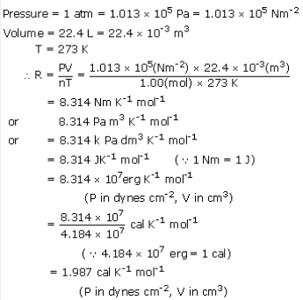
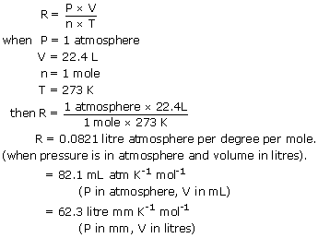
Derivation of value of R

Slide 12
Some important definitions
The mean free path is the distance that a molecule travels between two successive collisions.
Collisional Frequency is the average rate in which two reactant molecules collide for a given system and is used to express the average number of collisions per unit of time in a defined system.
The distance between the centers of two molecules taking part in a collision at the time of their closest approach is called collision diameter

Slide 13
Root-Mean-Square Velocities of Gaseous Particles
Measuring the velocities of particles at a given time results in a large distribution of values; some particles may move very slowly, others very quickly, and because they are constantly moving in different directions, the velocity could equal zero. (Velocity is a vector quantity, equal to the speed and direction of a particle) To properly assess the average velocity, average the squares of the velocities and take the square root of that value. This is known as the root-mean-square (RMS) velocity, and it is represented as follows:
V=Vrms=√3RT/M (The end)

